Slide 1
CSE428: Image Processing
Lecture 5: Point Processing - Part 2

Slide 2

Histogram
Definition
For each gray level, how many pixels have that exact value
n_{k} is the number of pixels with with intensity r_{k}
Normalized histogram: for each gray level, what percentage of pixels have that exact value. I.e., “unnormalized” histogram divided by the total number of pixels
n_{k} is the number of pixels with with intensity r_{k} and N_{T} is the total number of pixels
Normalized histogram is also called the probability density function (PDF) - why?

Slide 3
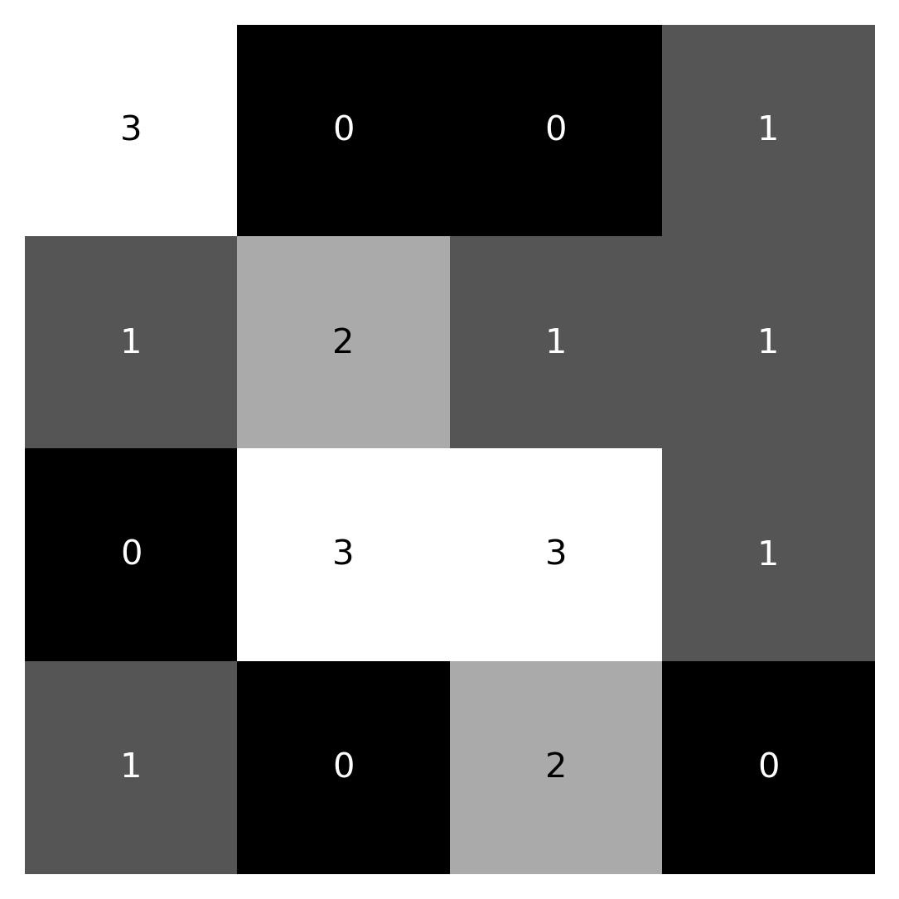
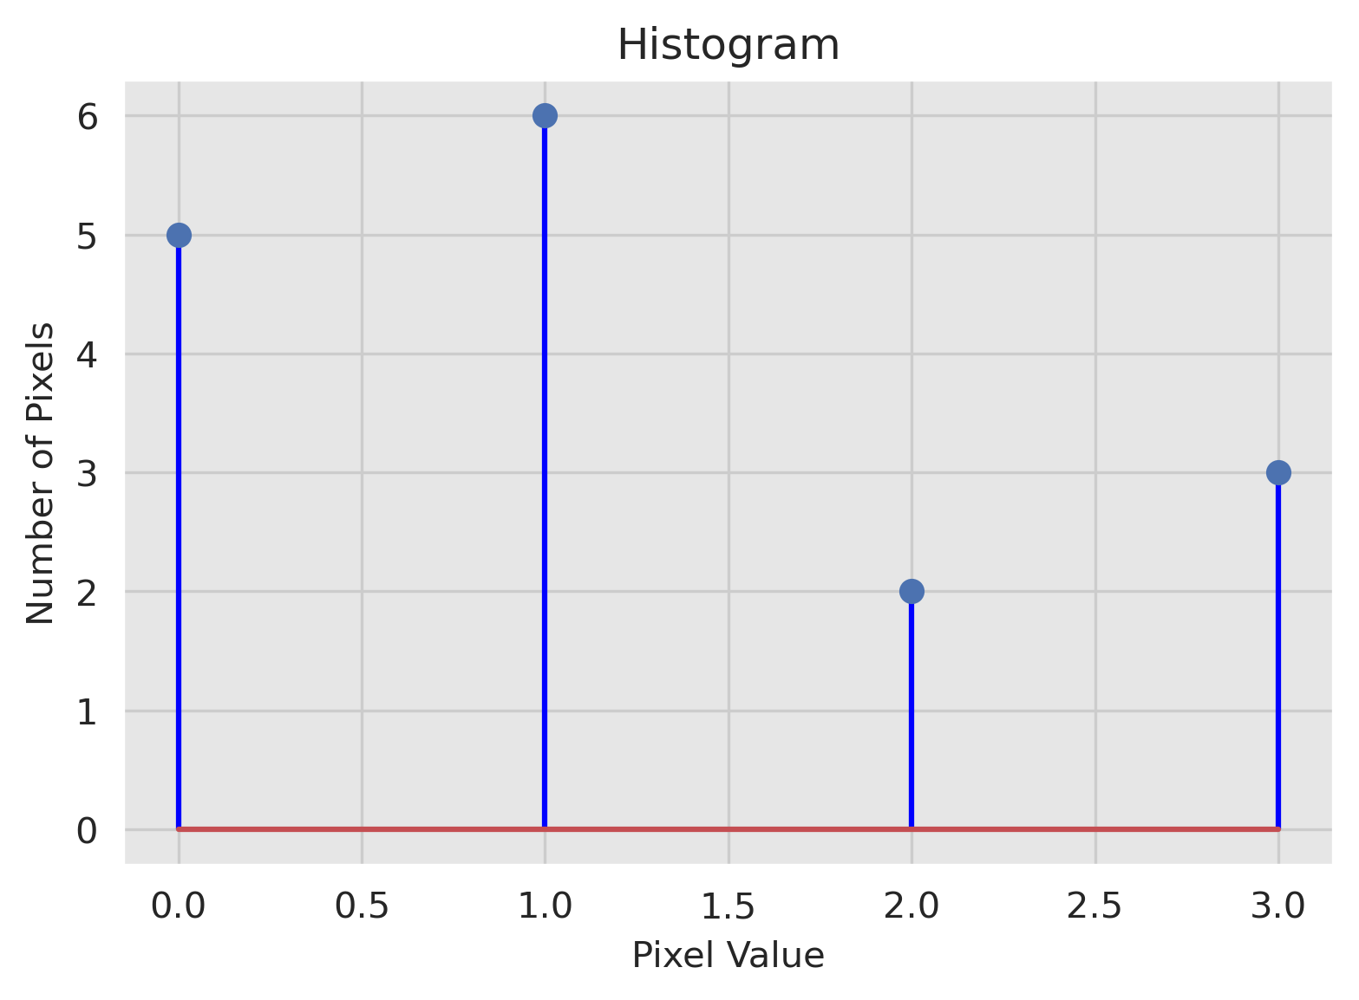
Histogram
Example
A (4 x 4) image with 2 bit or 4 quantization levels
r_{k} | n_{k}
0 | 5
1 | 6
2 | 2
3 | 3

Slide 4
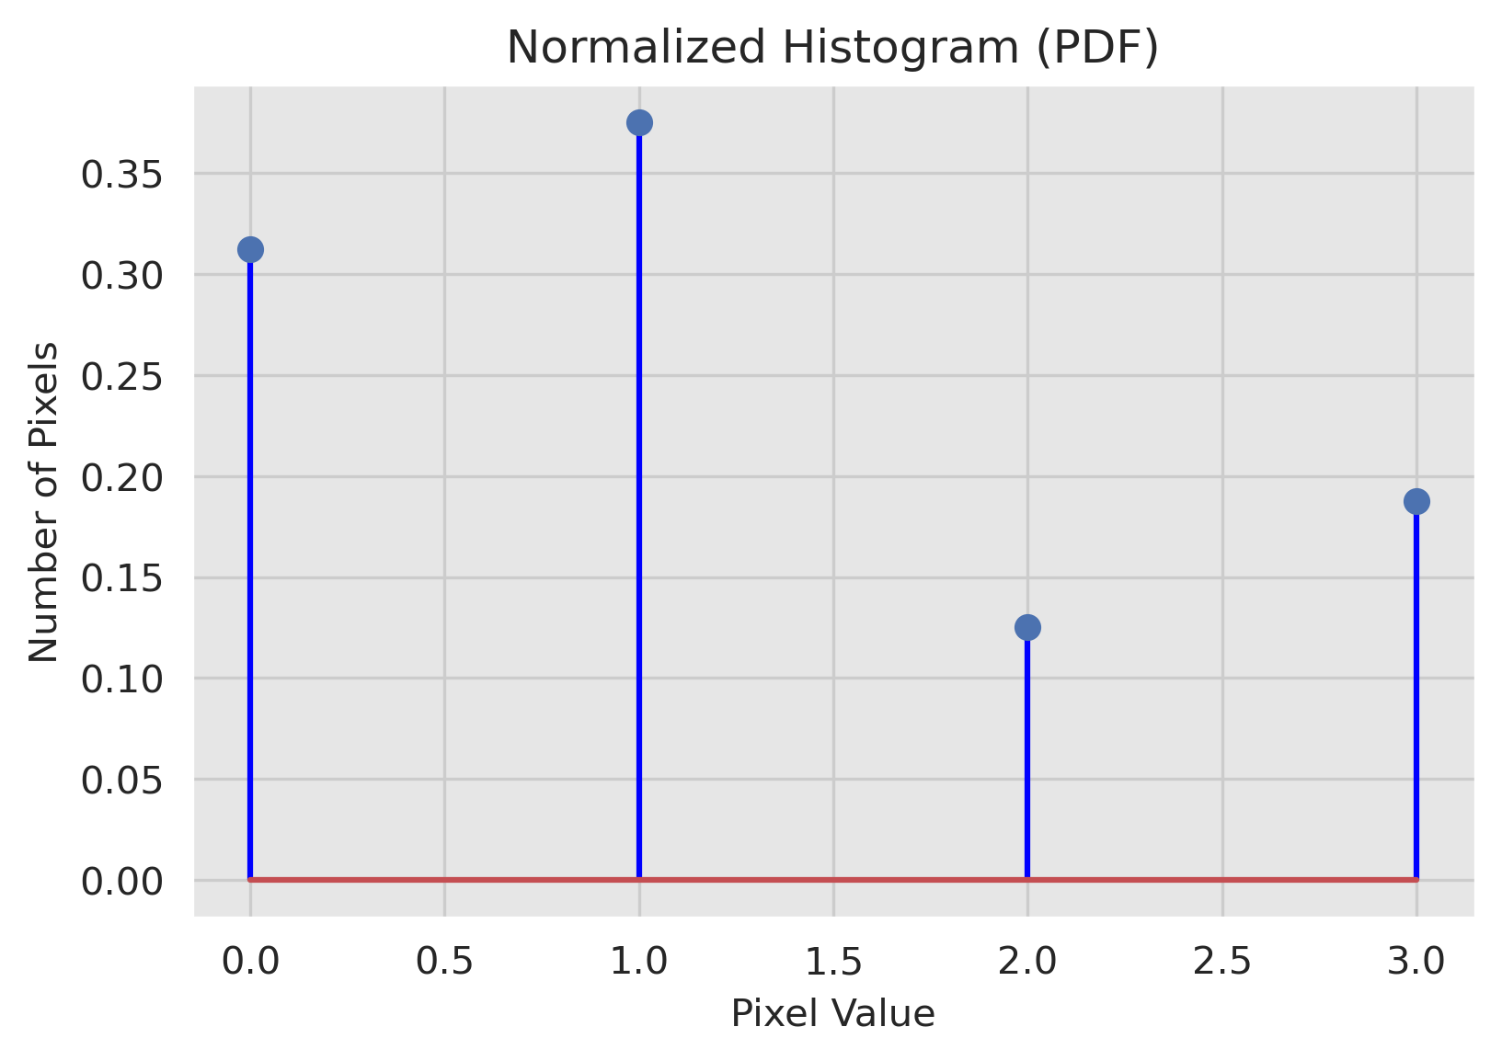
Histogram
Example
A (4 x 4) image with 2 bit or 4 quantization levels
r_{k} | n_{k} | f_{r}(r_{k})
0 | 5 | 0.31
1 | 6 | 0.38
2 | 2 | 0.12
3 | 3 | 0.19

Slide 5



Histogram
Histograms are not unique!
All of these images have the exact same histogram (equal number of black and white)

Slide 6

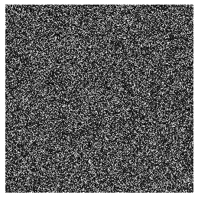
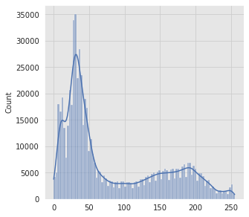
Histogram
Histograms are not unique!
The second image is a pixel permutation of the first image, hence same histogram

Slide 7
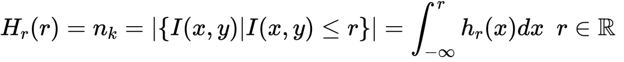
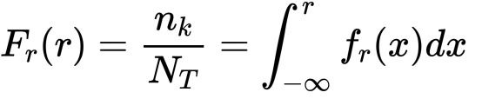
Cumulative Histogram
Definition
For a given gray level, how many pixels have values ≤ that value.
n_{k} is the number of pixels with with intensity ≤ r.
Integration of histogram = cumulative histogram.
Normalized cumulative histogram: for each gray level, what percentage of pixels have values ≤ that value. Also now as cumulative density function (CDF).
Interpretation of CDF(r) = probability that a randomly chosen pixel will have value ≤ r

Slide 8
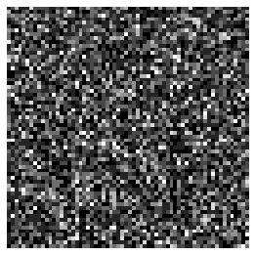
Cumulative Histogram
Example
A random (64 x 64) image with 3 bit or 8 quantization levels
r_{k} | h(r_{k})
0 | 790
1 | 1023
2 | 850
3 | 656
4 | 329
5 | 245
6 | 122
7 | 81

Slide 9
Cumulative Histogram
Example
A random (64 x 64) image with 3 bit or 8 quantization levels
r_{k} | h(r_{k}) | f(r_{k}) [PDF]
0 | 790 | 0.19 (=790/4096)
1 | 1023 | 0.25 (=1023/4096)
2 | 850
3 | 656
4 | 329
5 | 245
6 | 122
7 | 81

Slide 10
Cumulative Histogram
Example
A random (64 x 64) image with 3 bit or 8 quantization levels
r_{k} | h(r_{k}) | f(r_{k}) [PDF]
0 | 790 | 0.19
1 | 1023 | 0.25
2 | 850 | 0.21
3 | 656 | 0.16
4 | 329 | 0.08
5 | 245 | 0.06
6 | 122 | 0.03
7 | 81 | 0.02

Slide 11
Cumulative Histogram
Example
A random (64 x 64) image with 3 bit or 8 quantization levels
r_{k} | h(r_{k}) | f(r_{k}) [PDF] | H(r_{k})
0 | 790 | 0.19 | 790
1 | 1023 | 0.25
2 | 850 | 0.21
3 | 656 | 0.16
4 | 329 | 0.08
5 | 245 | 0.06
6 | 122 | 0.03
7 | 81 | 0.02

Slide 12
Cumulative Histogram
Example
A random (64 x 64) image with 3 bit or 8 quantization levels
r_{k} | h(r_{k}) | f(r_{k}) [PDF] | H(r_{k})
0 | 790 | 0.19 | 790
1 | 1023 | 0.25 | 1813 (=790+1023)
2 | 850 | 0.21
3 | 656 | 0.16
4 | 329 | 0.08
5 | 245 | 0.06
6 | 122 | 0.03
7 | 81 | 0.02

Slide 13
Cumulative Histogram
Example
A random (64 x 64) image with 3 bit or 8 quantization levels
r_{k} | h(r_{k}) | f(r_{k}) [PDF] | H(r_{k})
0 | 790 | 0.19 | 790
1 | 1023 | 0.25 | 1813
2 | 850 | 0.21 | 2663 = (1813+850)
3 | 656 | 0.16
4 | 329 | 0.08
5 | 245 | 0.06
6 | 122 | 0.03
7 | 81 | 0.02

Slide 14
Cumulative Histogram
Example
A random (64 x 64) image with 3 bit or 8 quantization levels
r_{k} | h(r_{k}) | f(r_{k}) [PDF] | H(r_{k})
0 | 790 | 0.19 | 790
1 | 1023 | 0.25 | 1813
2 | 850 | 0.21 | 2663
3 | 656 | 0.16 | 3319
4 | 329 | 0.08 | 3648
5 | 245 | 0.06 | 3893
6 | 122 | 0.03 | 4015
7 | 81 | 0.02 | 4096

Slide 15
Cumulative Histogram
Example
A random (64 x 64) image with 3 bit or 8 quantization levels
r_{k} | h(r_{k}) | f(r_{k}) [PDF] | H(r_{k}) | F(r_{k}) [CDF]
0 | 790 | 0.19 | 790 | 0.19
1 | 1023 | 0.25 | 1813 | 0.44
2 | 850 | 0.21 | 2663 | 0.65
3 | 656 | 0.16 | 3319 | 0.81
4 | 329 | 0.08 | 3648 | 0.89
5 | 245 | 0.06 | 3893 | 0.95
6 | 122 | 0.03 | 4015 | 0.98
7 | 81 | 0.02 | 4096 | 1.00

Slide 16
Cumulative Histogram
Example
A random (64 x 64) image with 3 bit or 8 quantization levels
r_{k} | h(r_{k}) | f(r_{k}) [PDF] | H(r_{k}) | F(r_{k}) [CDF]
0 | 790 | 0.19 | 790 | 0.19
1 | 1023 | 0.25 | 1813 (=790+1023) | 0.44
2 | 850 | 0.21 | 2663 | 0.65
3 | 656 | 0.16 | 3319 | 0.81
4 | 329 | 0.08 | 3648 | 0.89
5 | 245 | 0.06 | 3893 | 0.95
6 | 122 | 0.03 | 4015 | 0.98
7 | 81 | 0.02 | 4096 | 1.00

Slide 17
Cumulative Histogram
Example
A random (64 x 64) image with 3 bit or 8 quantization levels
r_{k} | h(r_{k}) | f(r_{k}) [PDF] | H(r_{k}) | F(r_{k}) [CDF]
0 | 790 | 0.19 | 790 | 0.19
1 | 1023 | 0.25 | 1813 (=790+1023) | 0.44
2 | 850 | 0.21 | 2663 (=1813+850) | 0.65
3 | 656 | 0.16 | 3319 | 0.81
4 | 329 | 0.08 | 3648 | 0.89
5 | 245 | 0.06 | 3893 | 0.95
6 | 122 | 0.03 | 4015 | 0.98
7 | 81 | 0.02 | 4096 | 1.00

Slide 18
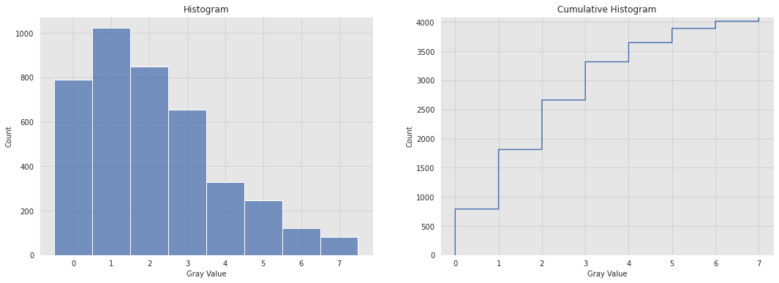
Cumulative Histogram
Example
A random (64 x 64) image with 3 bit or 8 quantization levels

Slide 19
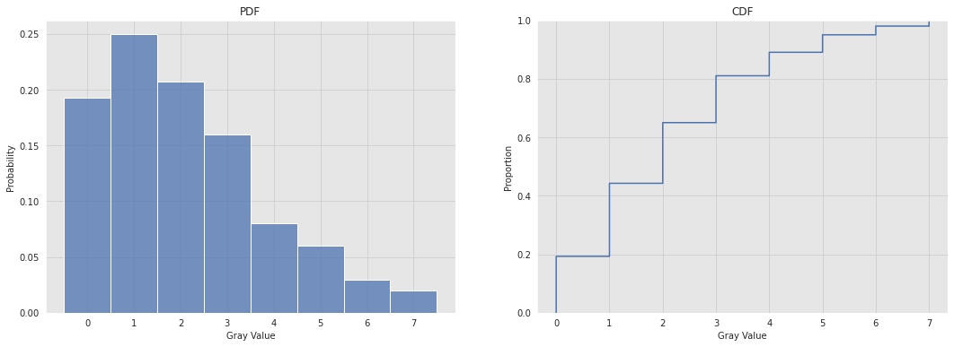
Cumulative Histogram
Example
A random (64 x 64) image with 3 bit or 8 quantization levels

Slide 20
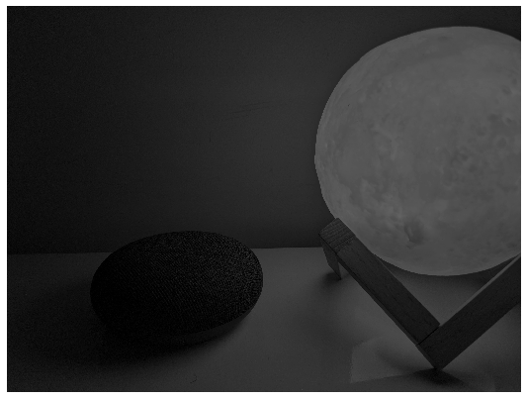
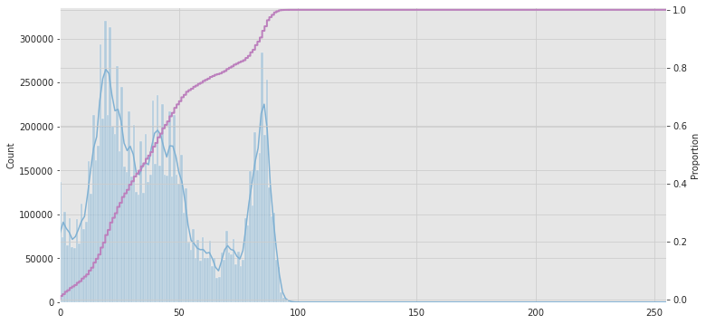
Histogram
More Example
Histogram of a dark image.
The histogram is concentrated in the low-range gray values

Slide 21
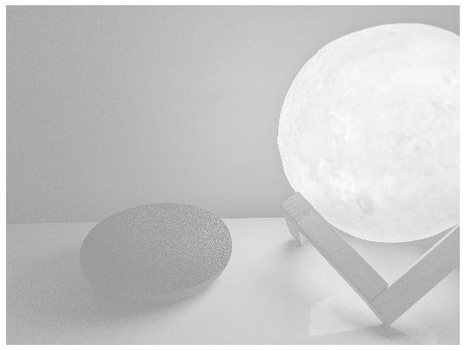
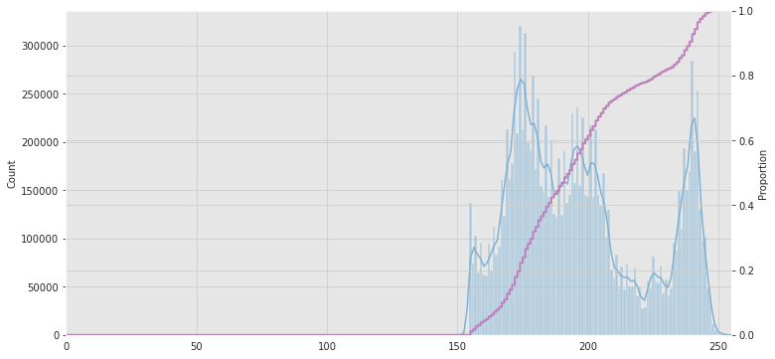
Histogram
More Example
Histogram of a bright image.
The histogram is concentrated in the high-range gray values

Slide 22
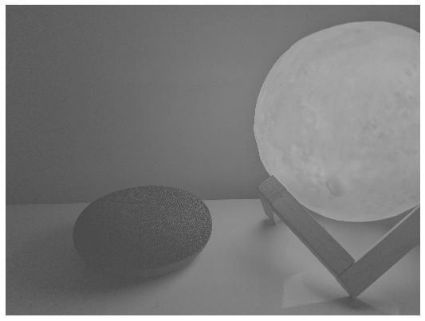
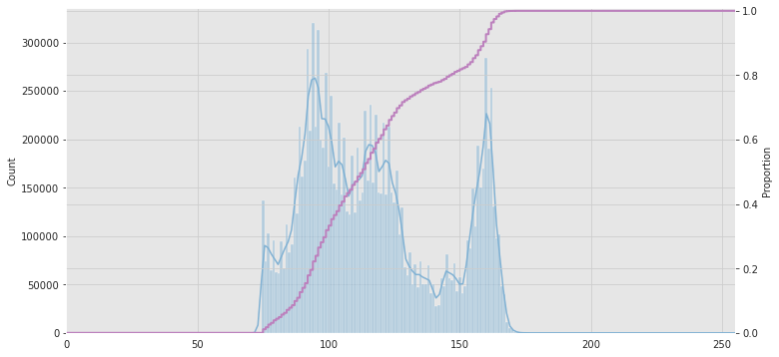
Histogram
More Example
Histogram of a low contrast image
The histogram is concentrated in the mid-range gray values
The image looks “washed-out”

Slide 23
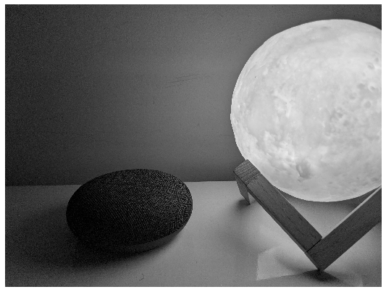
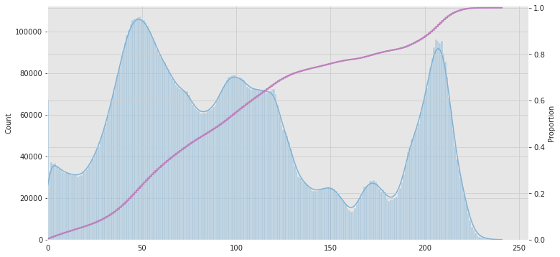
Histogram
More Example
Histogram of a high contrast image
The histogram is (somewhat) uniformly distributed
Contrast can be further increased by “flattening” the histogram

Slide 24
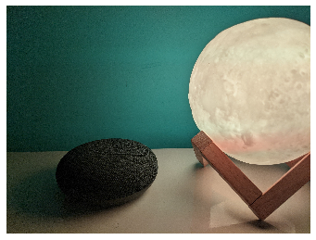
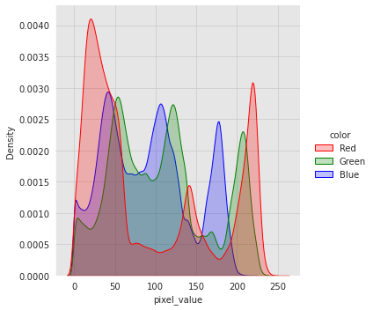
Histogram
More Example
Histograms of a color image
The distribution of the three color channels are calculated separately

Slide 25
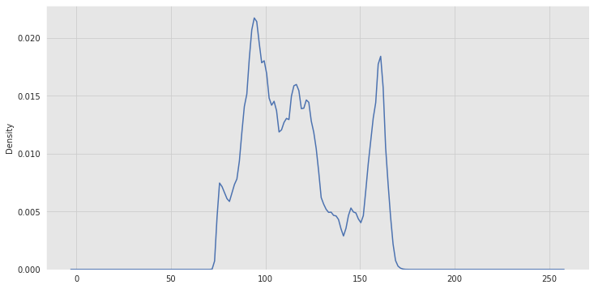
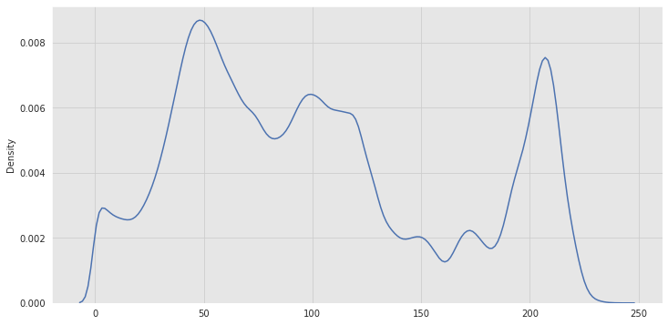
Contrast Stretching
Histogram Point of View
s = T(r)?

Slide 26
Contrast Stretching
Histogram Point of View
L → 0 H → 255
L
H
s = T(r)?

Slide 27
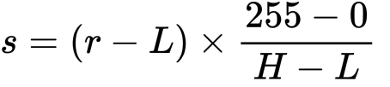
Contrast Stretching
Histogram Point of View
L → 0 H → 255
L
H
s = T(r)?

Slide 28
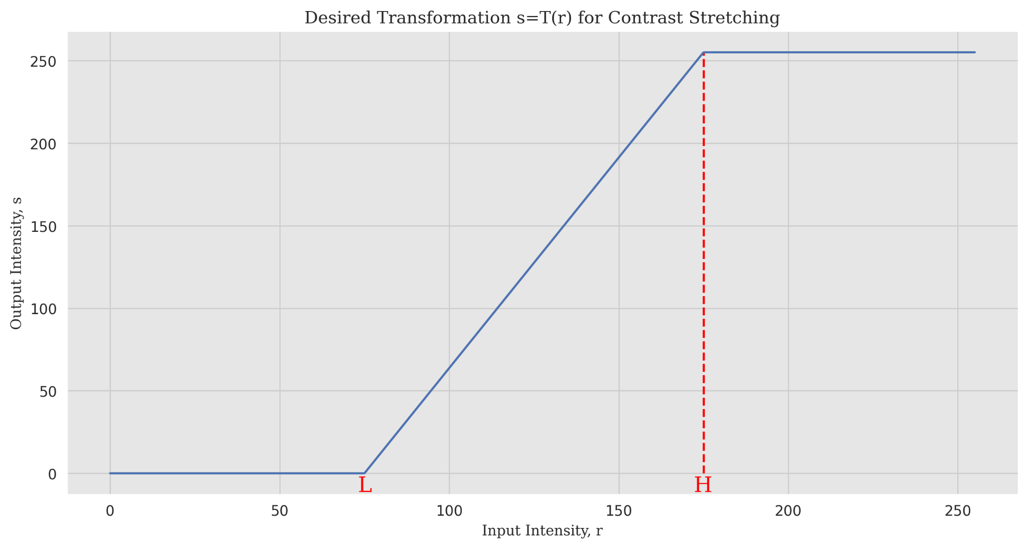
Contrast Stretching
Histogram Point of View
L → 0 H → 255
L
H
s = T(r)?

Slide 29
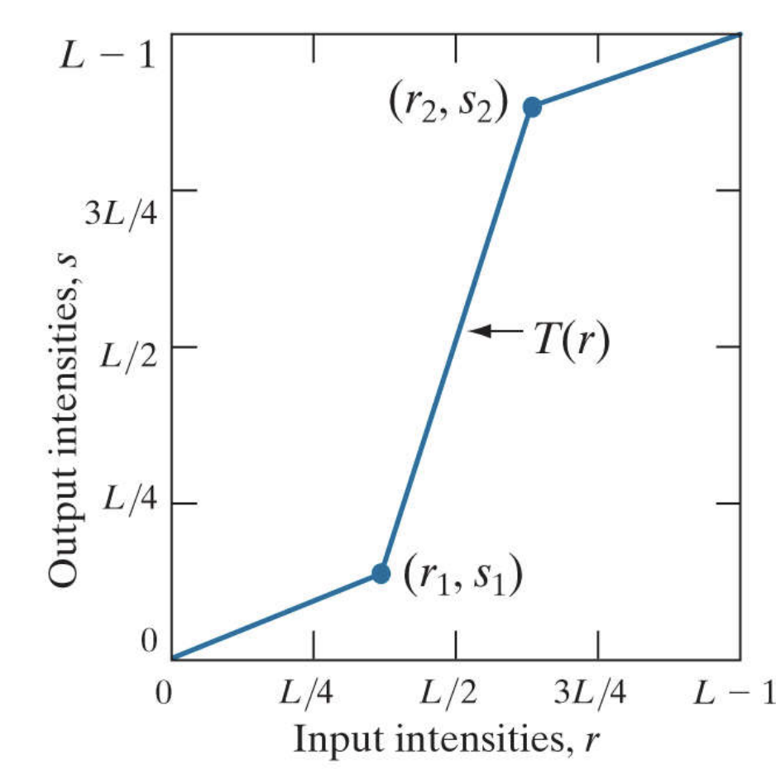
Contrast Stretching
Histogram Point of View
L
H
s = T(r)?
By Rafael C. Gonzalez & Richard E. Woods, 2018, Digital Image Processing, 4th Edition

Slide 30
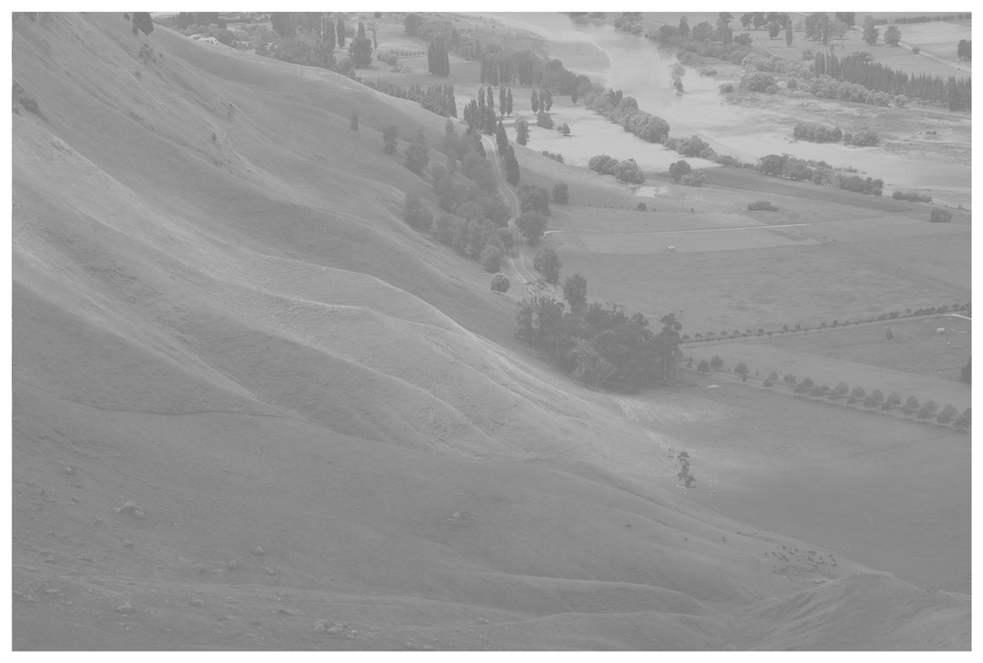
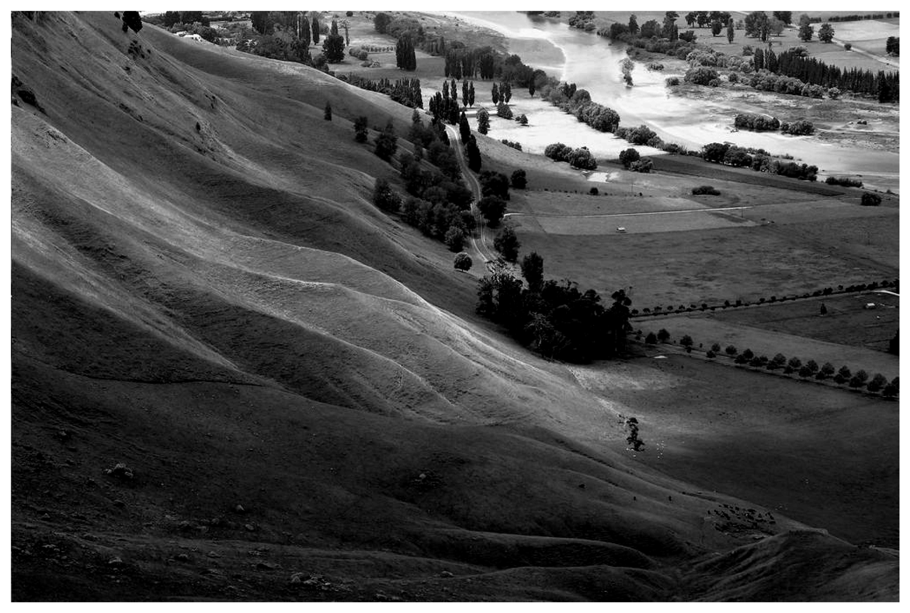
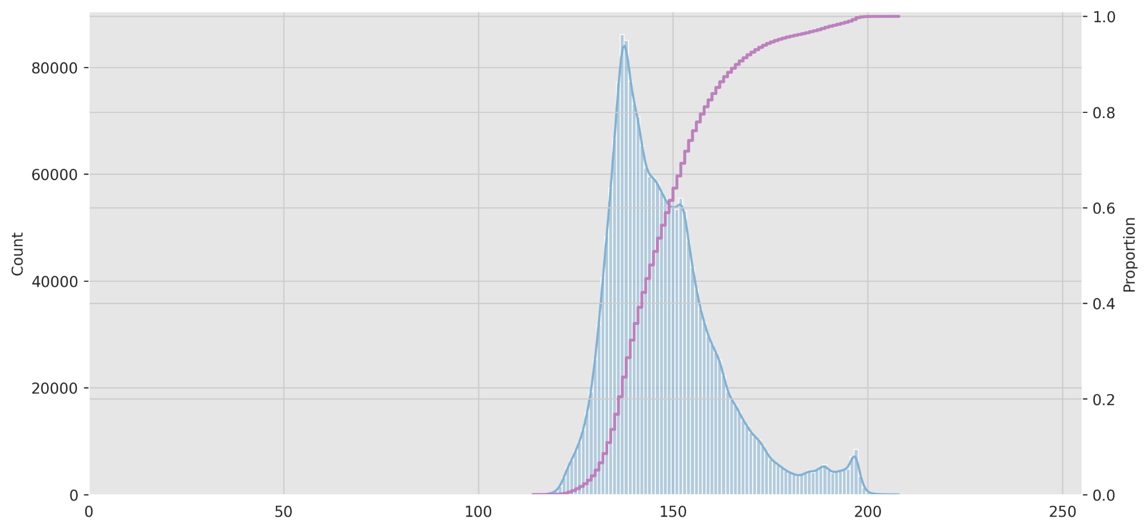
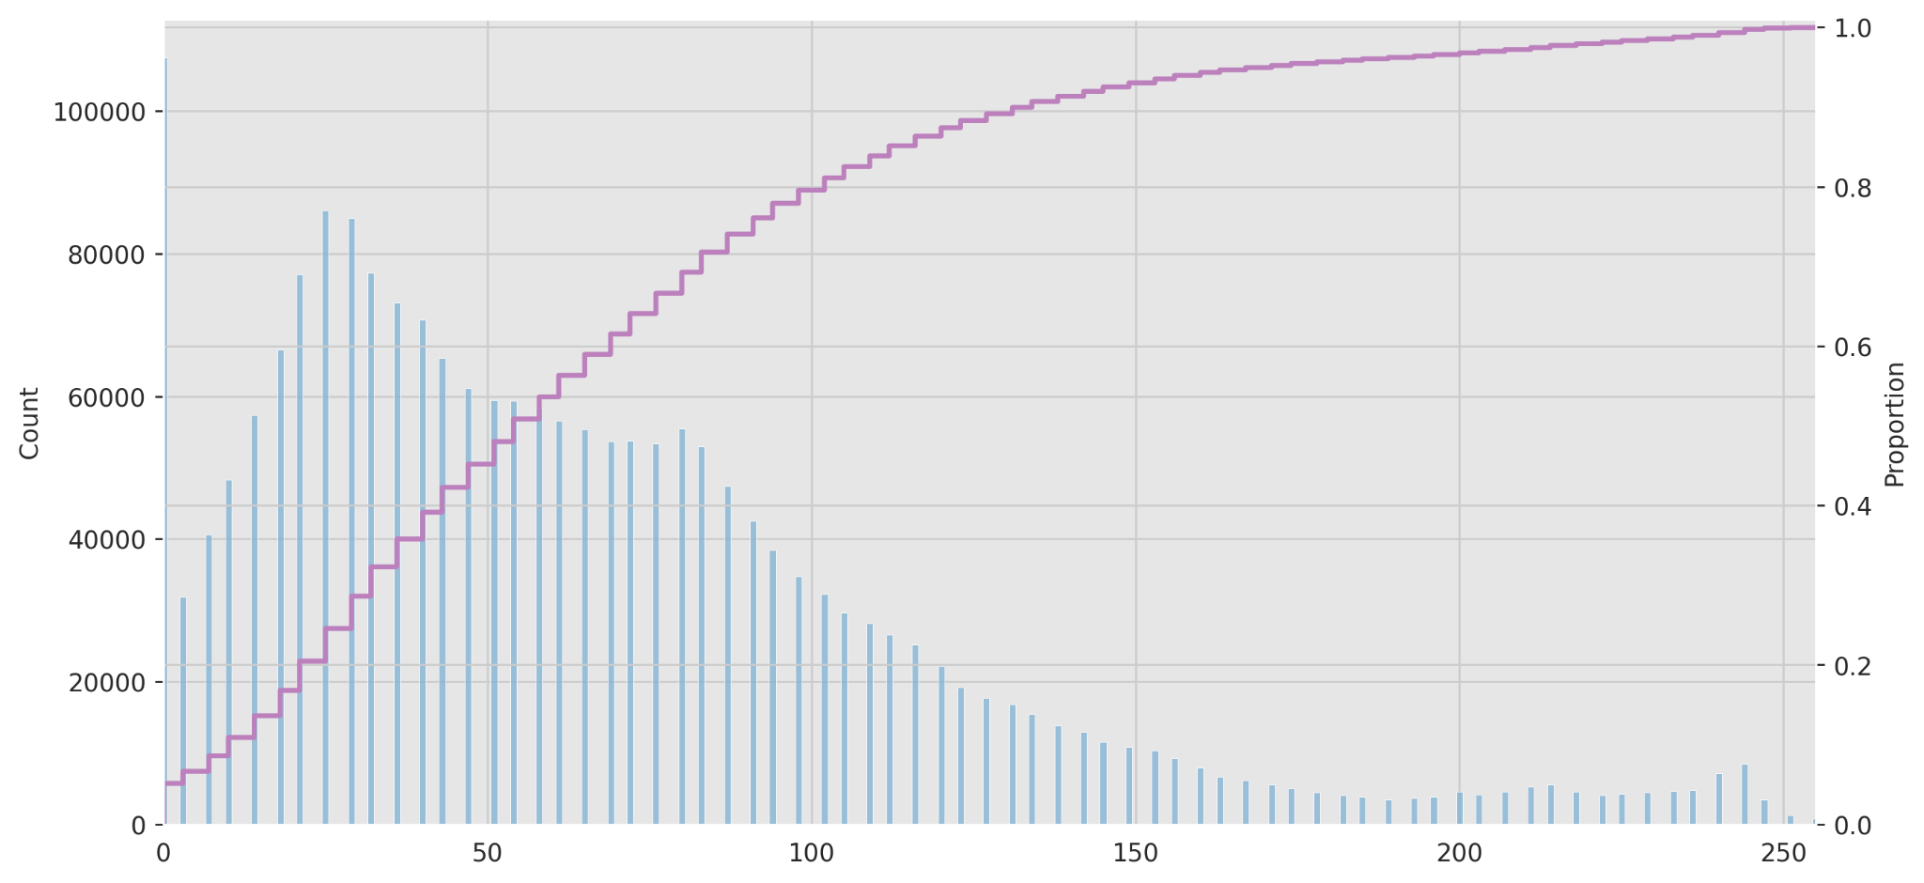
Contrast Stretching
Histogram Point of View
a
b
a
b

Slide 31
Can we do better?

Slide 32
Can we do better? - YES!

Slide 33
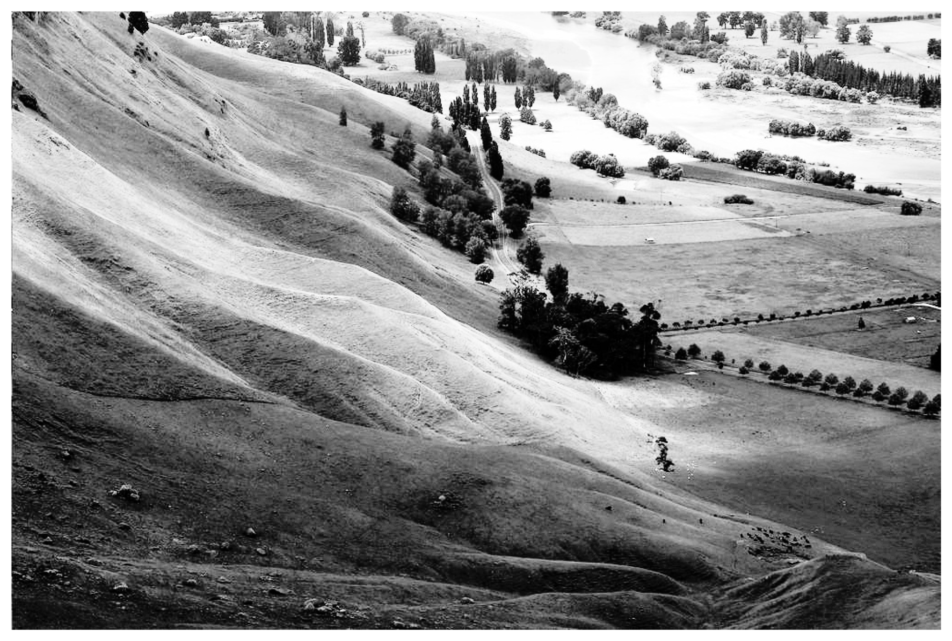
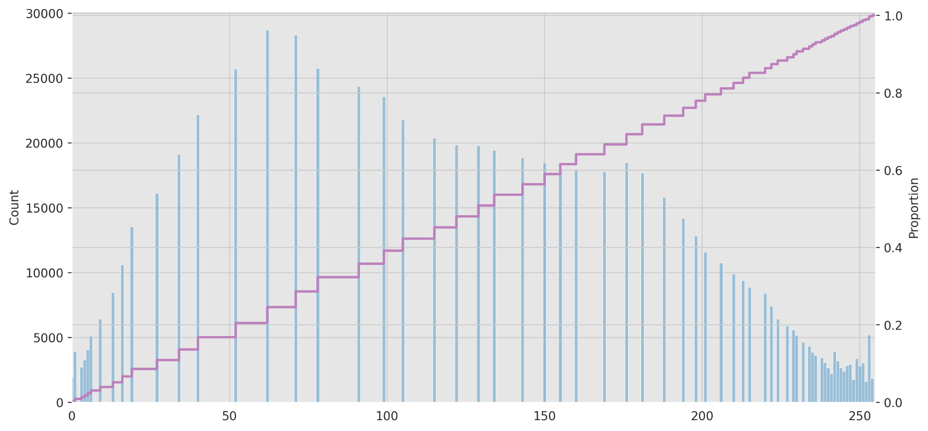
Histogram Equalization
Demo
a
b
a
b

Slide 34
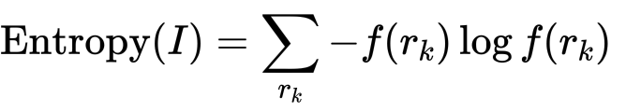
Histogram Equalization
Motivation - Entropy
Entropy specifies the uncertainty of image pixels
Uncertain events have more information than certain events
Entropy is a measure of dispersion of histograms
Uniform distribution - dispersed, high entropy, high contrast (desirable)
Entropy = 6.34
Entropy = 7.64

Slide 35
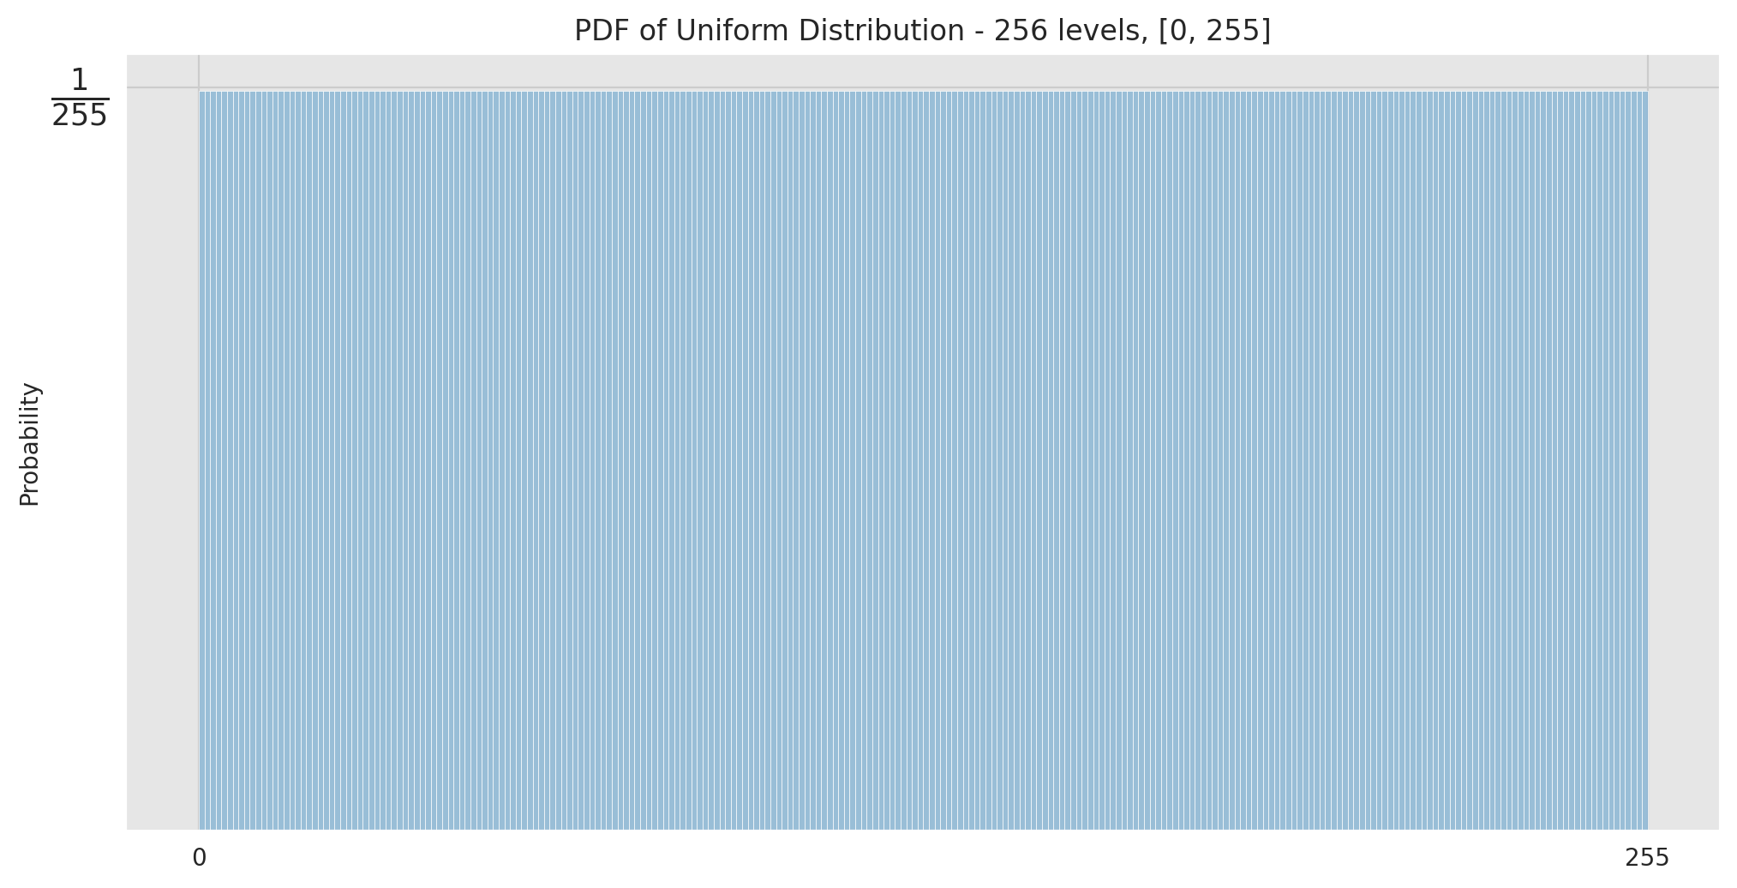
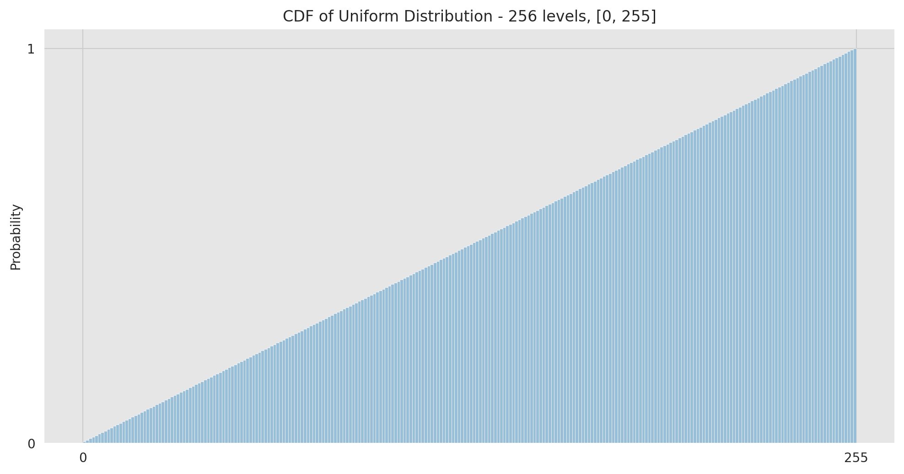
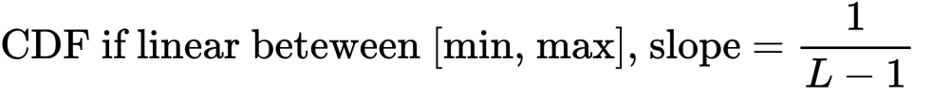
Histogram Equalization
Motivation - Uniform Distribution

Slide 36

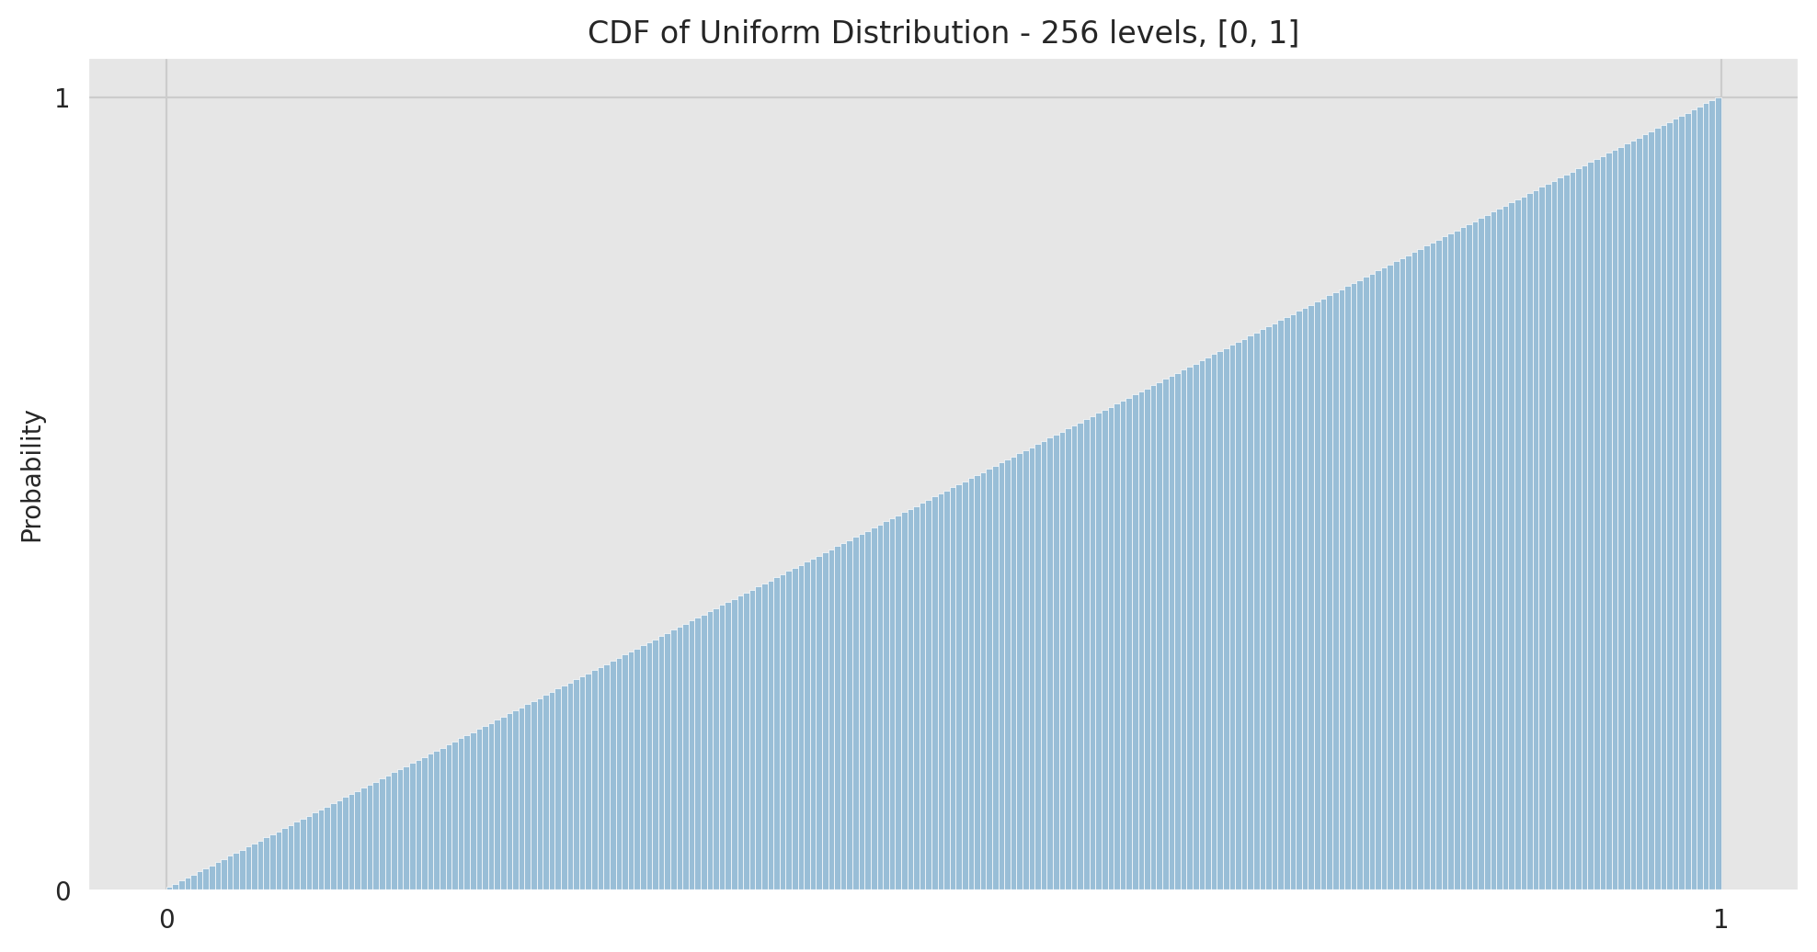
Histogram Equalization
Motivation - Uniform Distribution

Slide 37
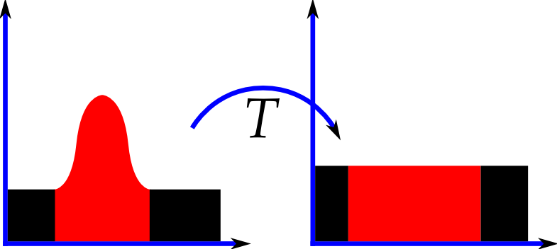
Histogram Equalization
Basic Idea for Histogram Equalization
By Zefram - Own work, Public Domain, https://commons.wikimedia.org/w/index.php?curid=668605
Goal: Find a map s = T(r) such that the resulting PDF is flat, i.e., the resulting CDF is linear

Slide 38
Histogram Equalization
Basic Idea for Histogram Equalization
Observation (Assuming normalized gray values)
For an ideal uniform distribution, y% pixels have values less than y [see the CDF]
Reverse: A pixel with y% pixels having smaller values than itself should have a value y
By Zefram - Own work, Public Domain, https://commons.wikimedia.org/w/index.php?curid=668605
Goal: Find a map s = T(r) such that the resulting PDF is flat, i.e., the resulting CDF is linear

Slide 39
Histogram Equalization
Basic Idea for Histogram Equalization
Observation (Assuming normalized gray values)
For an ideal uniform distribution, y% pixels have values less than y [see the CDF]
Reverse: A pixel with y% pixels having smaller values than itself should have a value y
Idea (Assuming normalized gray values [0, 1])
For a given gray value x, we know the percentage of pixels with values ≤ x (CDF)
Hence, map x to its CDF value to get a flat histogram/linear CDF.
By Zefram - Own work, Public Domain, https://commons.wikimedia.org/w/index.php?curid=668605
Goal: Find a map s = T(r) such that the resulting PDF is flat, i.e., the resulting CDF is linear

Slide 40
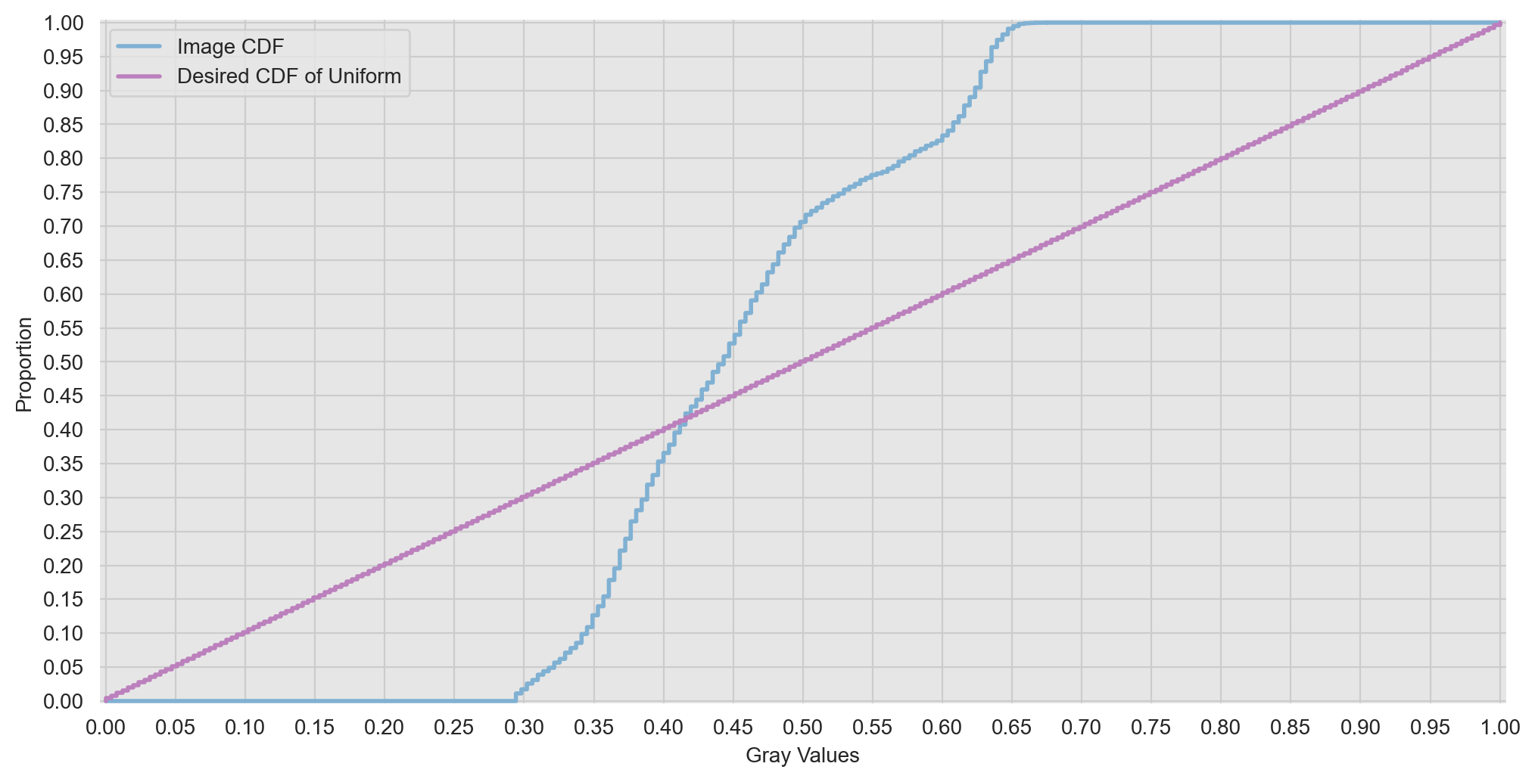

Histogram Equalization
Basic Idea for Histogram Equalization

Slide 41
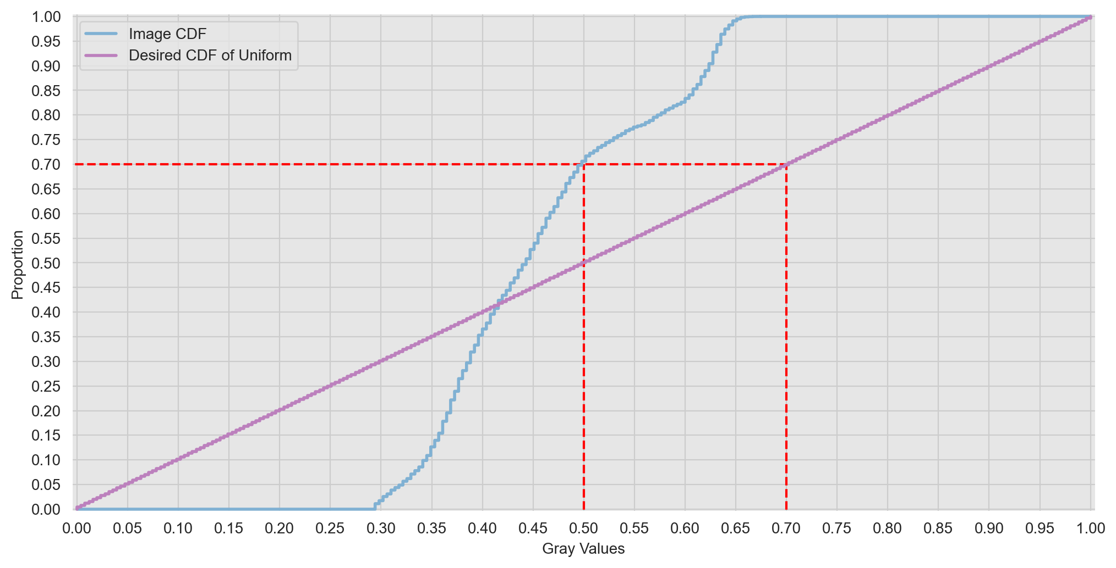

Histogram Equalization
Basic Idea for Histogram Equalization

Slide 42


Histogram Equalization
Basic Idea for Histogram Equalization

Slide 43
Histogram Equalization
Numerical Example
A random (64 x 64) image with 3 bit or 8 quantization levels (L = 8)
r_{k} | h(r_{k}) | f(r_{k}) [PDF] | H(r_{k}) | F(r_{k}) [CDF]
0 | 790 | 0.19 | 790 | 0.19
1 | 1023 | 0.25 | 1813 | 0.44
2 | 850 | 0.21 | 2663 | 0.65
3 | 656 | 0.16 | 3319 | 0.81
4 | 329 | 0.08 | 3648 | 0.89
5 | 245 | 0.06 | 3893 | 0.95
6 | 122 | 0.03 | 4015 | 0.98
7 | 81 | 0.02 | 4096 | 1.00

Slide 44
Histogram Equalization
Numerical Example
A random (64 x 64) image with 3 bit or 8 quantization levels (L = 8)
r_{k} | h(r_{k}) | f(r_{k}) [PDF] | H(r_{k}) | F(r_{k}) [CDF] | s_{k} = round(7xF(r_{k}))
0 | 790 | 0.19 | 790 | 0.19
1 | 1023 | 0.25 | 1813 | 0.44
2 | 850 | 0.21 | 2663 | 0.65
3 | 656 | 0.16 | 3319 | 0.81
4 | 329 | 0.08 | 3648 | 0.89
5 | 245 | 0.06 | 3893 | 0.95
6 | 122 | 0.03 | 4015 | 0.98
7 | 81 | 0.02 | 4096 | 1.00

Slide 45
Histogram Equalization
Numerical Example
A random (64 x 64) image with 3 bit or 8 quantization levels (L = 8)
r_{k} | h(r_{k}) | f(r_{k}) [PDF] | H(r_{k}) | F(r_{k}) [CDF] | s_{k} = round(7xF(r_{k}))
0 | 790 | 0.19 | 790 | 0.19 | =round(7 x 0.19)
1 | 1023 | 0.25 | 1813 | 0.44
2 | 850 | 0.21 | 2663 | 0.65
3 | 656 | 0.16 | 3319 | 0.81
4 | 329 | 0.08 | 3648 | 0.89
5 | 245 | 0.06 | 3893 | 0.95
6 | 122 | 0.03 | 4015 | 0.98
7 | 81 | 0.02 | 4096 | 1.00

Slide 46
Histogram Equalization
Numerical Example
A random (64 x 64) image with 3 bit or 8 quantization levels (L = 8)
r_{k} | h(r_{k}) | f(r_{k}) [PDF] | H(r_{k}) | F(r_{k}) [CDF] | s_{k} = round(7xF(r_{k}))
0 | 790 | 0.19 | 790 | 0.19 | =round(1.33)
1 | 1023 | 0.25 | 1813 | 0.44
2 | 850 | 0.21 | 2663 | 0.65
3 | 656 | 0.16 | 3319 | 0.81
4 | 329 | 0.08 | 3648 | 0.89
5 | 245 | 0.06 | 3893 | 0.95
6 | 122 | 0.03 | 4015 | 0.98
7 | 81 | 0.02 | 4096 | 1.00

Slide 47
Histogram Equalization
Numerical Example
A random (64 x 64) image with 3 bit or 8 quantization levels (L = 8)
r_{k} | h(r_{k}) | f(r_{k}) [PDF] | H(r_{k}) | F(r_{k}) [CDF] | s_{k} = round(7xF(r_{k}))
0 | 790 | 0.19 | 790 | 0.19 | 1
1 | 1023 | 0.25 | 1813 | 0.44
2 | 850 | 0.21 | 2663 | 0.65
3 | 656 | 0.16 | 3319 | 0.81
4 | 329 | 0.08 | 3648 | 0.89
5 | 245 | 0.06 | 3893 | 0.95
6 | 122 | 0.03 | 4015 | 0.98
7 | 81 | 0.02 | 4096 | 1.00

Slide 48
Histogram Equalization
Numerical Example
A random (64 x 64) image with 3 bit or 8 quantization levels (L = 8)
r_{k} | h(r_{k}) | f(r_{k}) [PDF] | H(r_{k}) | F(r_{k}) [CDF] | s_{k} = round(7xF(r_{k}))
0 | 790 | 0.19 | 790 | 0.19 | 1
1 | 1023 | 0.25 | 1813 | 0.44 | 3
2 | 850 | 0.21 | 2663 | 0.65 | 5
3 | 656 | 0.16 | 3319 | 0.81 | 6
4 | 329 | 0.08 | 3648 | 0.89 | 6
5 | 245 | 0.06 | 3893 | 0.95 | 7
6 | 122 | 0.03 | 4015 | 0.98 | 7
7 | 81 | 0.02 | 4096 | 1.00 | 7

Slide 49
Histogram Equalization
Numerical Example
A random (64 x 64) image with 3 bit or 8 quantization levels (L = 8)
r_{k} | h(r_{k}) | f(r_{k}) [PDF] | H(r_{k}) | F(r_{k}) [CDF] | s_{k} = round(7xF(r_{k}))
0 | 790 | 0.19 | 790 | 0.19 | 1
1 | 1023 | 0.25 | 1813 | 0.44 | 3
2 | 850 | 0.21 | 2663 | 0.65 | 5
3 | 656 | 0.16 | 3319 | 0.81 | 6
4 | 329 | 0.08 | 3648 | 0.89 | 6
5 | 245 | 0.06 | 3893 | 0.95 | 7
6 | 122 | 0.03 | 4015 | 0.98 | 7
7 | 81 | 0.02 | 4096 | 1.00 | 7

Slide 50
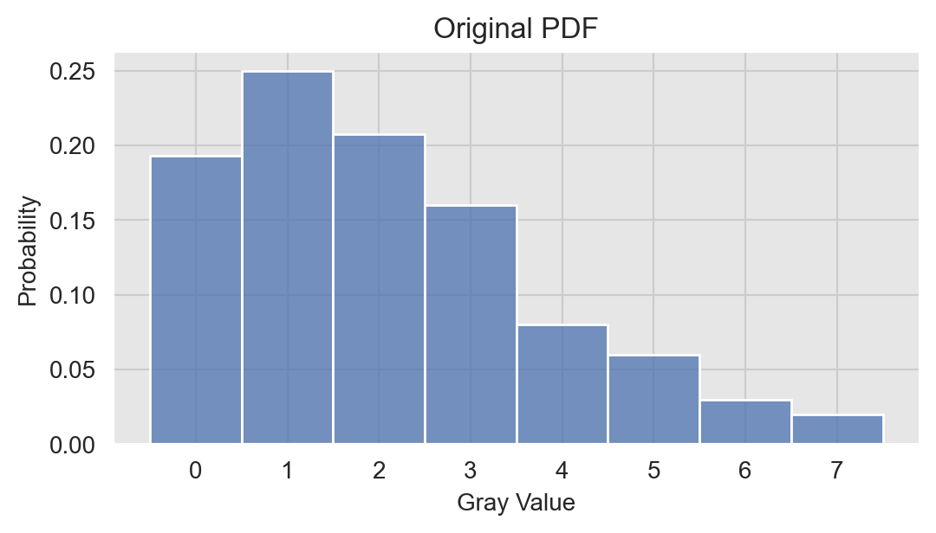
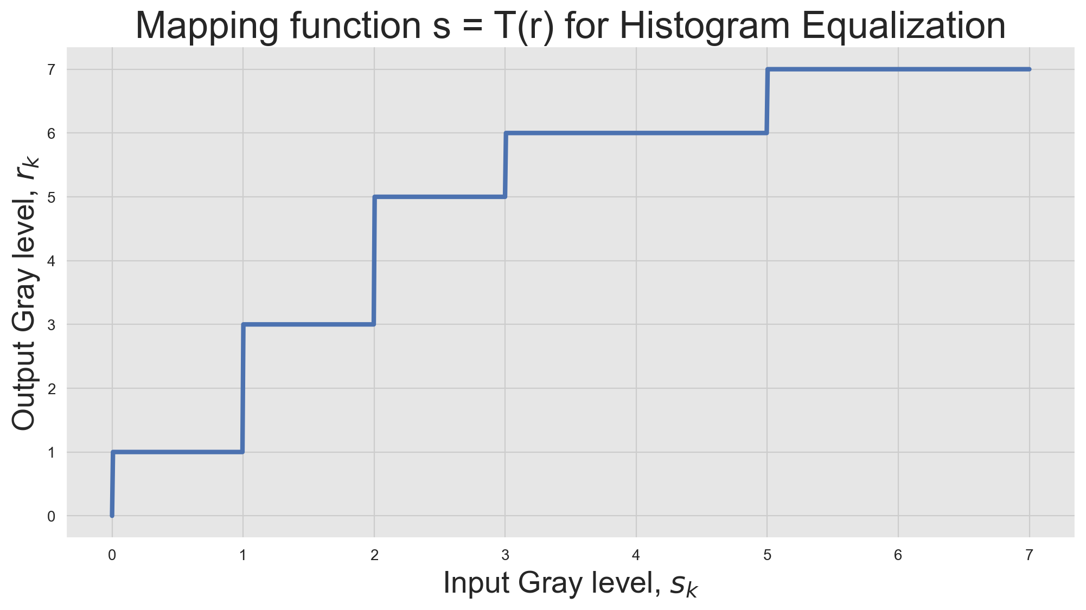
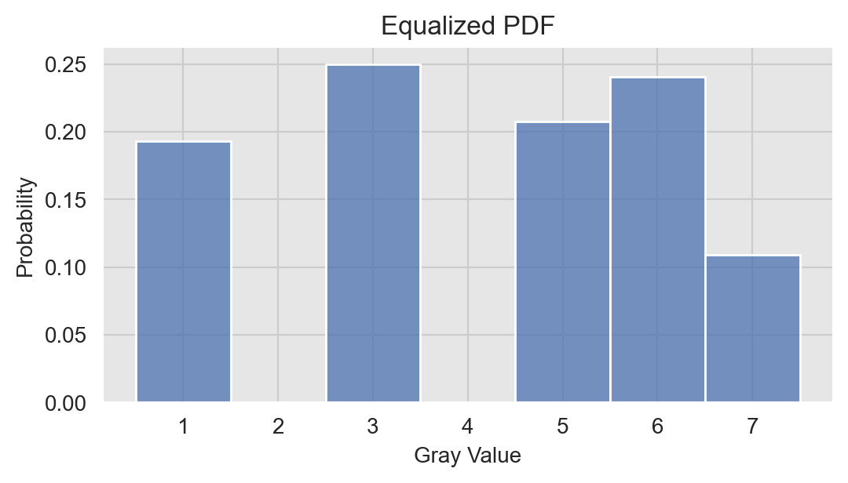
Histogram Equalization
Numerical Example
A random (64 x 64) image with 3 bit or 8 quantization levels (L = 8)

Slide 51
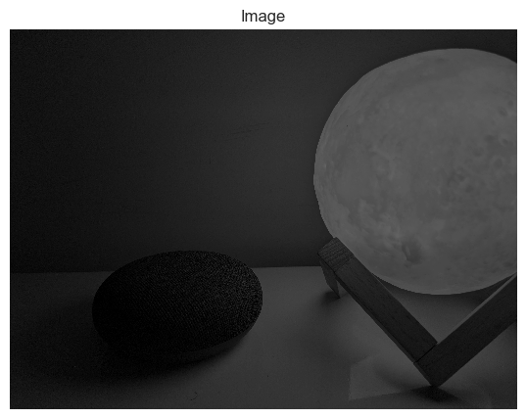
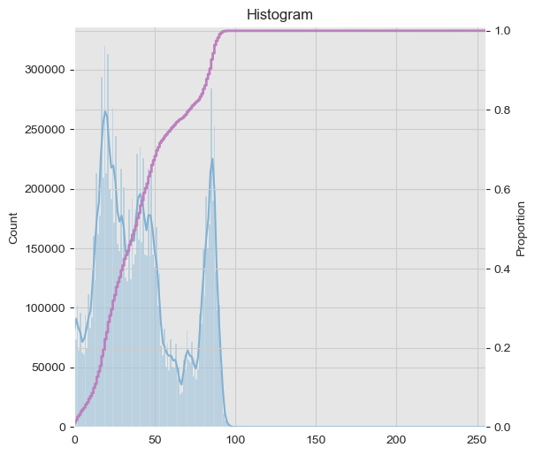
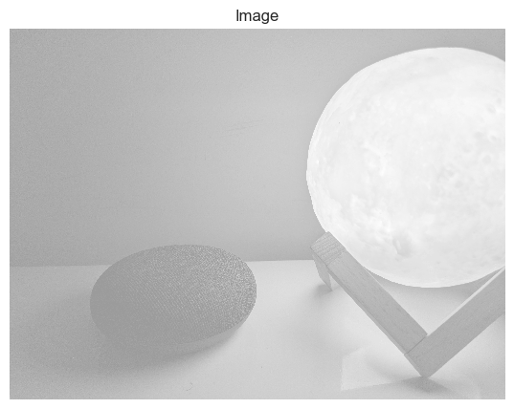
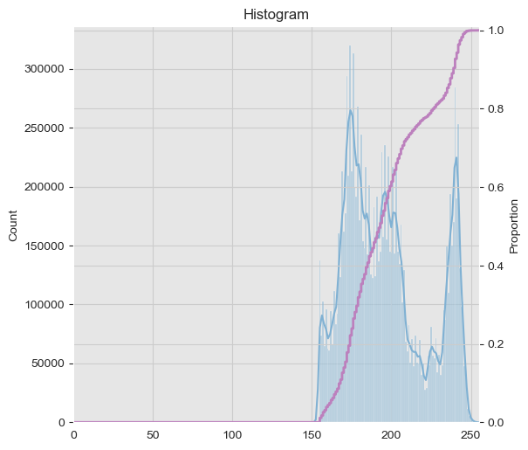
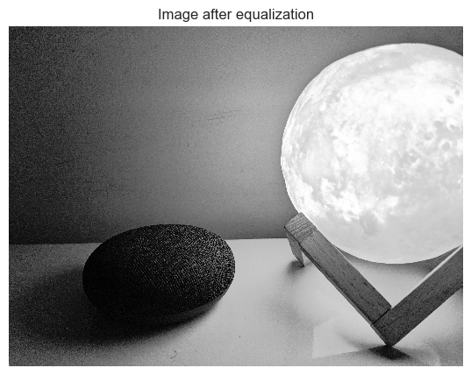
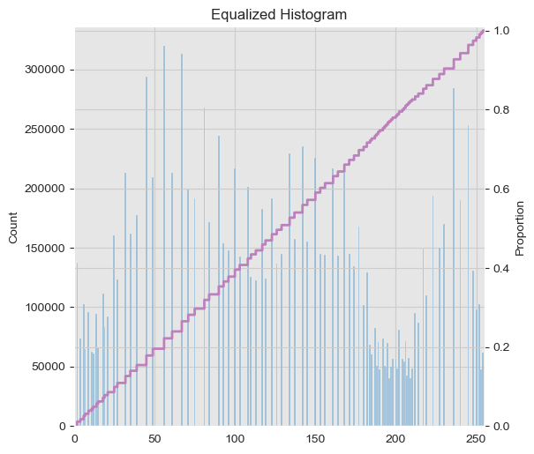

Histogram Equalization
Examples

Slide 52
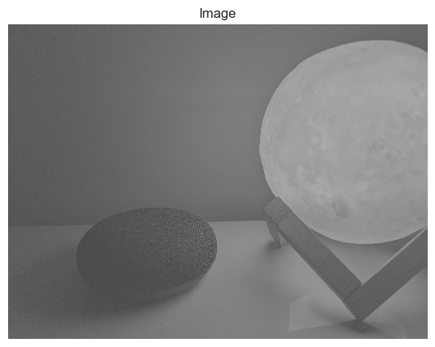
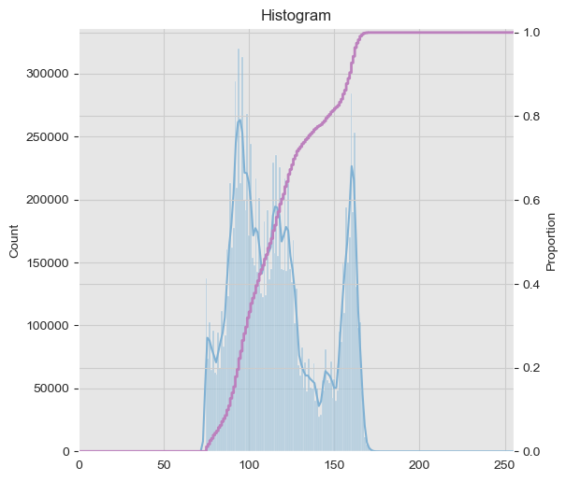




Histogram Equalization
Examples

Slide 53

Histogram Equalization
Example
Wrong method - channel wise equalization

Slide 54

Histogram Equalization
Example
Wrong method - channel wise equalization
Correct method - RGB to LAB, equalize L, LAB to RGB
https://en.wikipedia.org/wiki/CIELAB_color_space

Slide 55

Failure of Histogram Equalization
Details in low (or high) intensity value lost
Noise (grains) amplified
Reproduced from https://scikit-image.org/docs/stable/auto_examples/color_exposure/plot_equalize.html?highlight=histogram%20equalization

Slide 56




Failure of Histogram Equalization
Does not perform well for images with large area in low intensity region
“Equalized” histogram does not have linear CDF

Slide 57




Failure of Histogram Equalization
Flat histogram (linear CDF) not always good
Notice - Background much clear, but face details lost

Slide 58

Adaptive Histogram Equalization (AHE)
Idea
If image contains regions that are significantly lighter (or darker), the contrast in those regions will not be sufficiently enhanced.
Apply histogram equalization on a local neighbor
By Vswitchs - Own work, CC0, https://commons.wikimedia.org/w/index.php?curid=17467187

Slide 59

Adaptive Histogram Equalization (AHE)
Examples
By Rafael C. Gonzalez & Richard E. Woods, 2018, Digital Image Processing, 4th Edition
Original Image
Global Histogram Equalization
Local (3x3) Histogram Equalization

Slide 60

Adaptive Histogram Equalization (AHE)
Examples
Reproduced from https://scikit-image.org/docs/stable/auto_examples/color_exposure/plot_equalize.html?highlight=histogram%20equalization

Slide 61



Adaptive Histogram Equalization (AHE)
Examples
Original Image
Global Histogram Equalization
Local (36x36) Histogram Equalization

Slide 62


Adaptive Histogram Equalization (AHE)
Failure Example
Original Image
Global Histogram Equalization
Local (100x100) Histogram Equalization

Slide 63



Adaptive Histogram Equalization (AHE)
Failure Example
Original Image
Global Histogram Equalization
Local (100x100) Histogram Equalization

Slide 64

Contrast Limited Adaptive Histogram Equalization (CLAHE)
Both global and AHE tends to amplify the contrast in near-constant region
Result - noise amplification
Solution: Contrast Limited AHE (CLAHE), where the contrast amplification is limited
By Vswitchs - Own work, CC0, https://commons.wikimedia.org/w/index.php?curid=17500777

Slide 65
Contrast Limited Adaptive Histogram Equalization (CLAHE)
Original Image
Global Histogram Equalization
Local (100x100) Histogram Equalization
Clip limit = 1% of kernel size

Slide 66


Contrast Limited Adaptive Histogram Equalization (CLAHE)
Original Image
Global Histogram Equalization
Local (100x100) Histogram Equalization
Clip limit = 1% of kernel size

Slide 67

Contrast Limited Adaptive Histogram Equalization (CLAHE)
Original Image
Global Histogram Equalization
Local (100x100) Histogram Equalization
Clip limit = 5% of kernel size

Slide 68

Contrast Limited Adaptive Histogram Equalization (CLAHE)
Original Image
Global Histogram Equalization
Local (36x36) Histogram Equalization
Clip limit = 1% of kernel size

Slide 69

Histogram Matching (Specification)
Example
Reproduced from https://scikit-image.org/docs/stable/auto_examples/color_exposure/plot_histogram_matching.html?highlight=histogram%20equalization

Slide 70


Histogram Matching (Specification)
Example
Reproduced from https://scikit-image.org/docs/stable/auto_examples/color_exposure/plot_histogram_matching.html?highlight=histogram%20equalization

Slide 71

Histogram Matching
How to
By Llorenzi - https://commons.wikimedia.org/wiki/File:Histogram_matching.PNG, CC BY-SA 3.0, https://commons.wikimedia.org/w/index.php?curid=65976023

Slide 72

Histogram Matching
How to
By Llorenzi - https://commons.wikimedia.org/wiki/File:Histogram_matching.PNG, CC BY-SA 3.0, https://commons.wikimedia.org/w/index.php?curid=65976023

Slide 73

Histogram Matching
Example

Slide 74
Thank You!

